Slide 1
BOOK RECOMMENDATION SYSTEM
Presented By: Geek Squad
Suresh Ravuri
Ruchitha Reddy Koluguri
Harshavardhan Raghavendra Valmiki
Notes:
NOTE:
To change the image on this slide, select the picture and delete it. Then click the Pictures icon in the placeholder to insert your own image.

Slide 2
INTRODUCTION
What is a Recommendation System?
Recommender systems or Recommendation systems aim to predict user’s interests and recommend product items that quite likely are interesting for them. They are among the most powerful machine learning systems that online retailers implement in order to drive sales.
There are two primary types of recommender systems:
Collaborative Filtering Systems: These types of recommender systems are based on the user’s direct behavior. That is, this system builds a model of the user based on past choices, activities, and preferences. It then uses this knowledge to predict what the user will like based on their similarity to other user profiles.
Content-Based Filtering System: Content-based recommender systems, on the other hand, are based on the items, and not necessarily the users. This method builds an understanding of similarity between items. That is, it recommends items that are similar to each other in terms of properties.

Slide 3
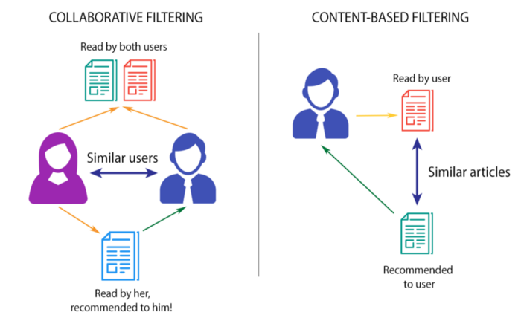
Fig 1- Collaborative Filtering Vs Content Based Filtering

Slide 4
OBJECTIVE
Develop a neural network-based book recommendation system to deliver personalized book suggestions that resonate with individual user preferences and reading habits.
Implement collaborative filtering approach by creating and learning from user and book embeddings, aiming to understand and utilize the intricate patterns of user-book interactions to enhance the quality of recommendations.
Focus on minimizing the mean squared error during training to improve the accuracy of predictions, with the system's success measured by its performance on unseen data, user engagement, and satisfaction metrics.

Slide 5
PROJECT ARCHITECTURE
Data Preprocessing:
Purpose: Clean and prepare the dataset for analysis. This includes handling missing values, normalizing data, and feature engineering.
Tools Used: Python libraries such as Pandas for data manipulation, NumPy for numerical operations, and possibly Scikit-learn for preprocessing functionalities.
Exploratory Data Analysis (EDA):
Purpose: Gain insights from the data through visualization and statistical analysis. This step involves understanding the distribution of data, identifying patterns, and detecting outliers.
Tools Used: Libraries like Matplotlib and Seaborn for visualization, along with Pandas for data exploration.

Slide 6
PROJECT ARCHITECTURE
Model Development:
Purpose: Build the recommendation algorithm. This involves neural networks which follows the collaborative filtering approach.
Tools Used: Machine learning libraries such as Scikit-learn for model building, and possibly deep learning libraries like TensorFlow for neural networks.
Testing Recommendations:
Purpose: Evaluate the effectiveness of the recommendation system. This involves testing the model on unseen data and assessing its performance.
Tools Used: Used the metrics RMSE (Root Mean Square Error) for evaluation.

Slide 7
DATASET INFORMATION
There have been good datasets for movies (Netflix, Movielens) and music (Million Songs) recommendation, but not for books. That is, until now.
This dataset contains ratings for ten thousand popular books. As to the source, let's say that these ratings were found on the internet. Generally, there are 100 reviews for each book, although some have less - fewer - ratings. Ratings go from one to five.
Both book IDs and user IDs are contiguous. For books, they are 1-10000, for users, 1-53424. All users have made at least two ratings. Median number of ratings per user is 8.
There are also books marked to read by the users, book metadata (author, year, etc.) and tags.
This dataset is taken from Kaggle. GoodBooks-10k

Slide 8
1. DATA PREPROCESSING
Objective:
Prepare and clean data for building the book recommendation model.
Key Steps:
Library Import: Utilized Pandas, NumPy, Matplotlib, Seaborn.
Data Loading: Read books.csv and ratings.csv.
Feature Selection: In books.csv, selected essential columns like id, book_id, authors, title, average_rating.
Data Cleaning: Handled missing values, dropped unnecessary features.
Ratings Check: Verified no missing values in ratings.csv.
Output: Cleaned books dataset saved as books_cleaned.csv.
Outcome:
Efficiently cleaned and streamlined dataset, ready for exploratory analysis and model development.
This slide provides a succinct overview of the data preprocessing stage, highlighting the main actions and outcomes.

Slide 9
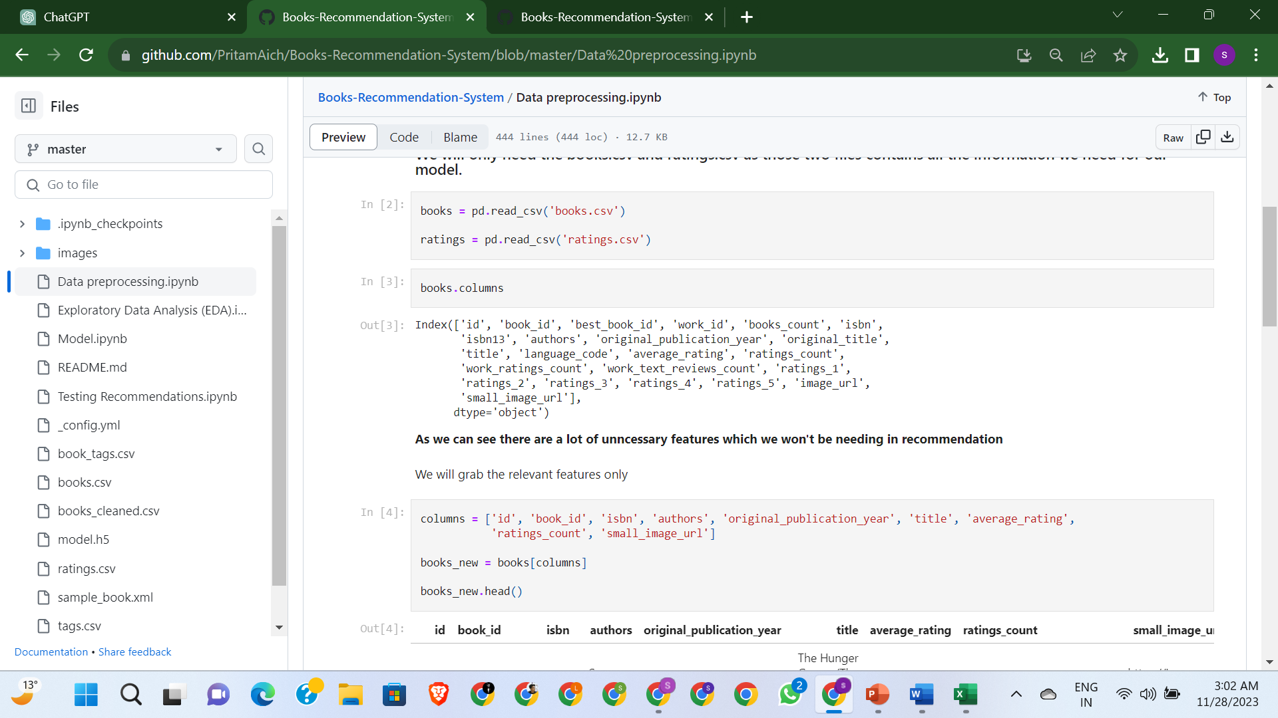
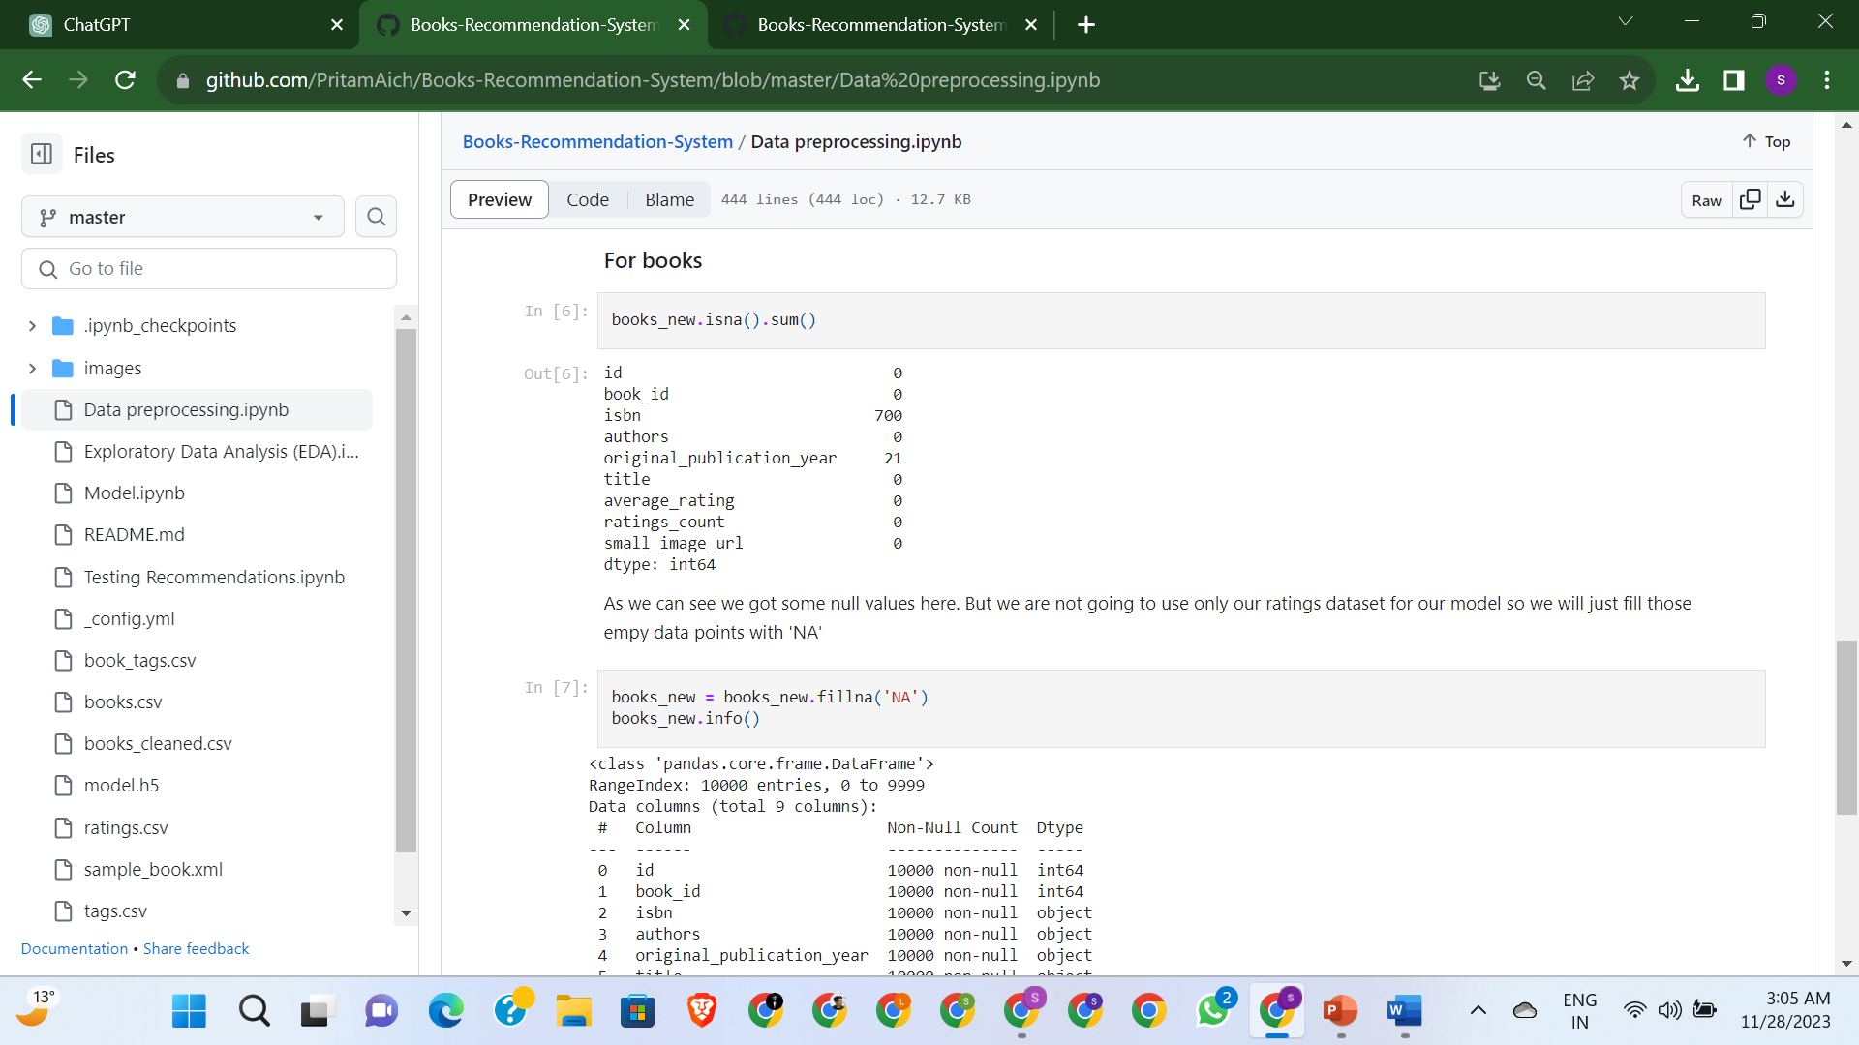
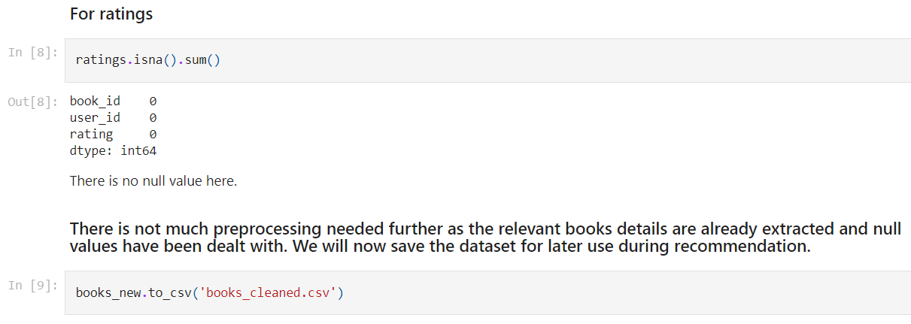
i) Selecting Essential Columns
ii) Handling Missing Values In books.csv
iii) Verifying No Missing Values In ratings.csv

Slide 10
2. Exploratory Data Analysis (EDA)
Objective:
The objective of this method is to perform exploratory data analysis on a dataset containing ratings for ten thousand popular books. The dataset includes user ratings, metadata like author and title, and user-assigned tags or genres. The goal is to gain insights into user preferences and trends in book ratings.
Key Steps:
Data Collection: Collecting and compiling data from various CSV files including ratings, to-read lists, book metadata, book tags, and tag translations.
Exploratory Data Analysis:
Analyzing the top-rated books and identifying patterns in ratings.
Investigating the most popular books based on user interactions.
Exploring top authors in terms of the number of ratings or popularity.
Analyzing the distribution of ratings to understand user rating behavior.

Slide 11
Outcomes:
The outcomes of the notebook would include:
Insights into user preferences for books, including popular genres, authors, and titles.
Understanding of the typical rating patterns and trends, such as the most common ratings given by users.
Identification of the most highly rated and popular books in the dataset.
A clearer picture of the book reading and rating habits of users, which could inform further analysis or the development of a book recommendation system.

Slide 12
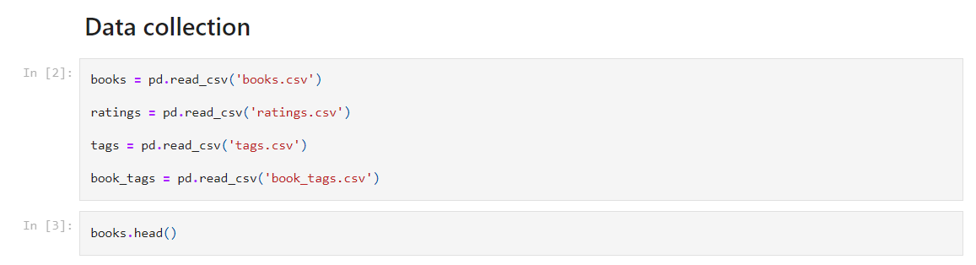
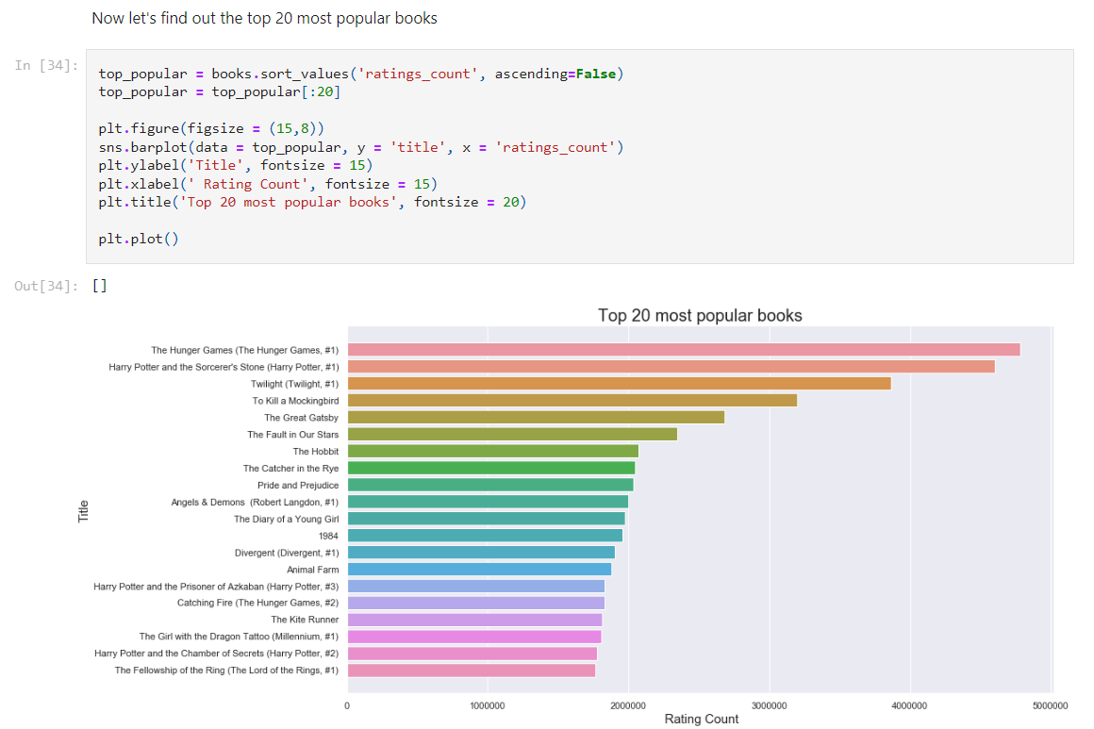
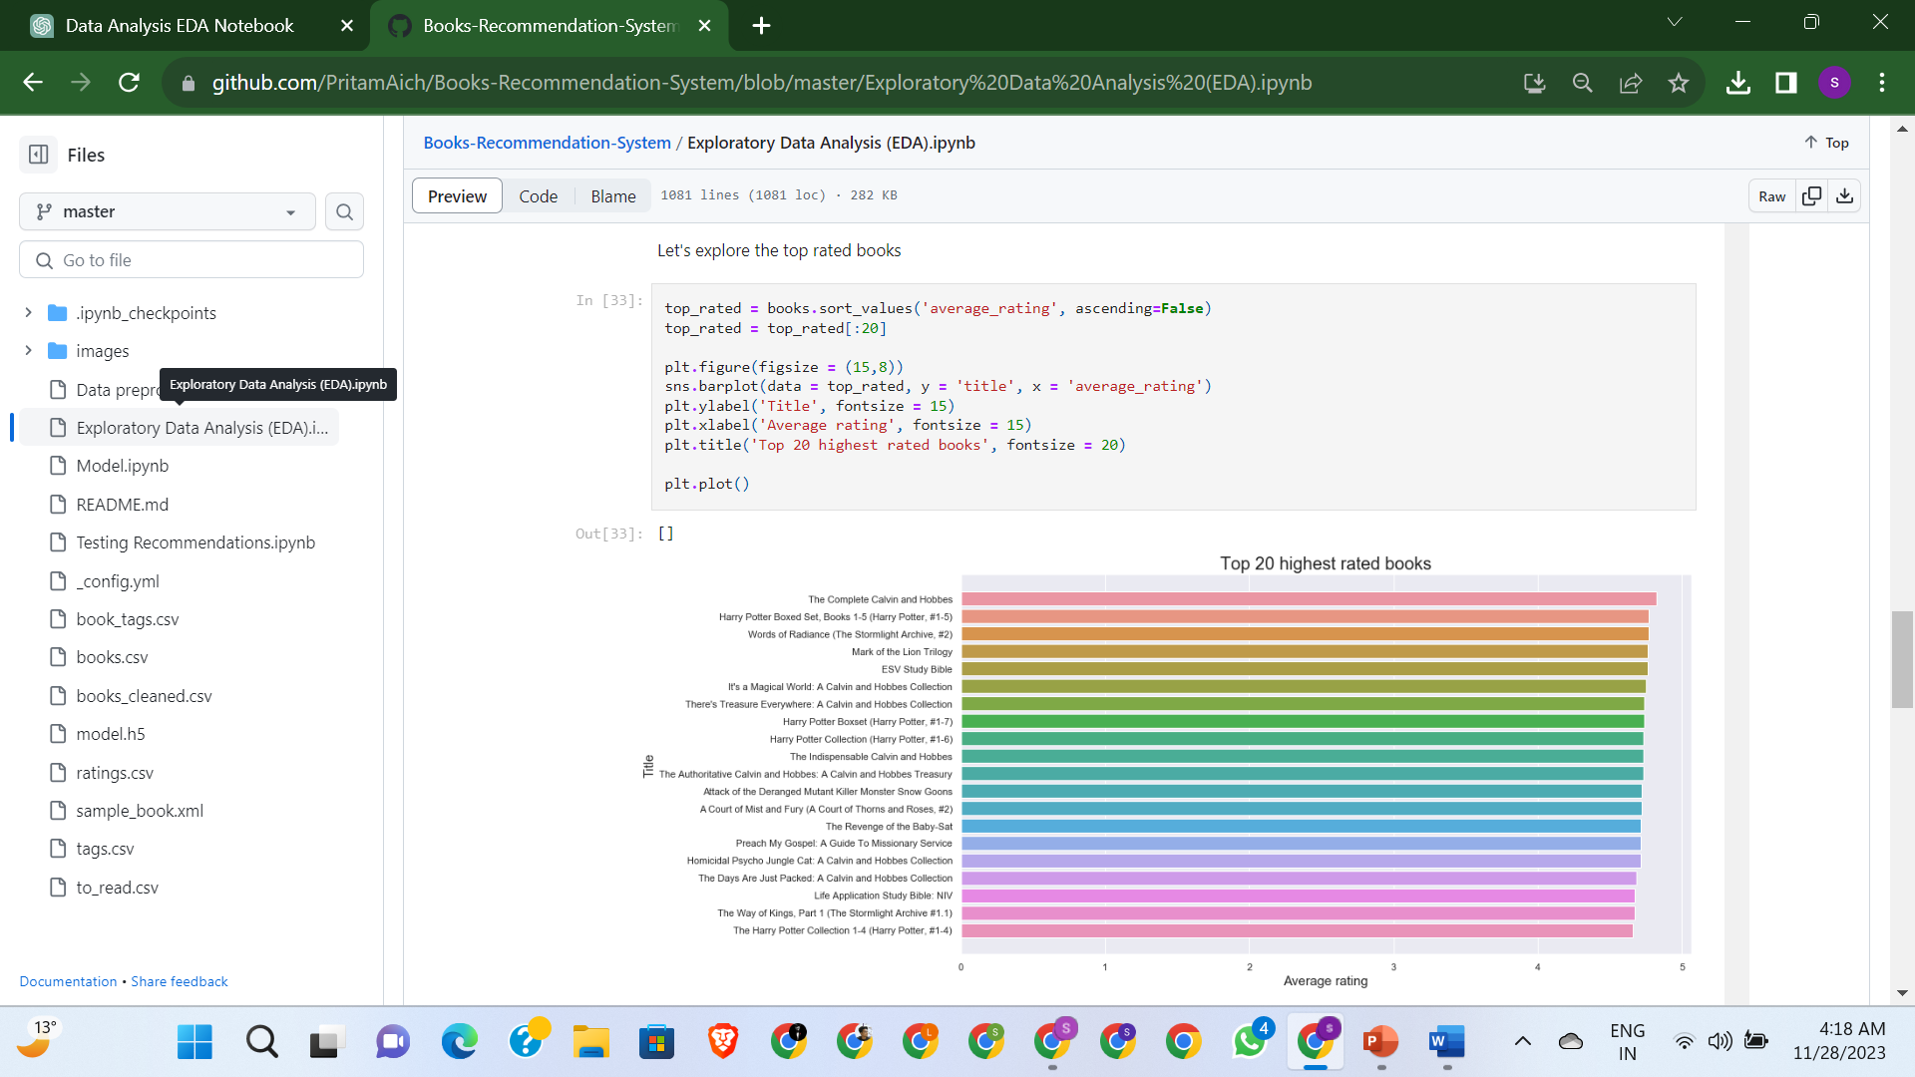

Slide 13
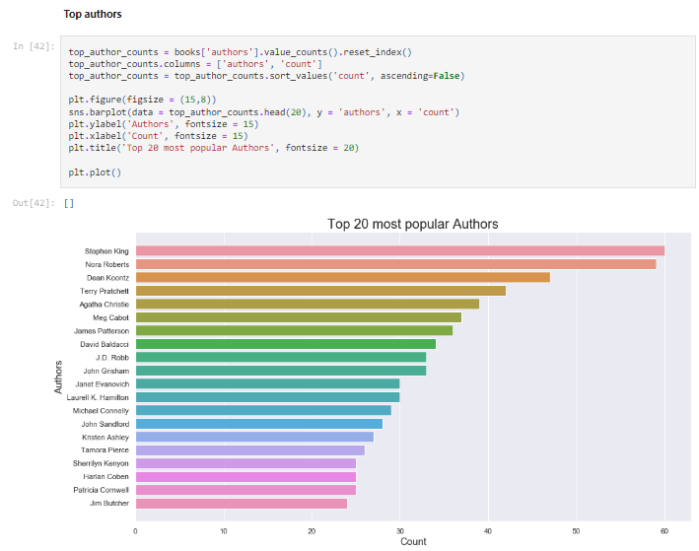
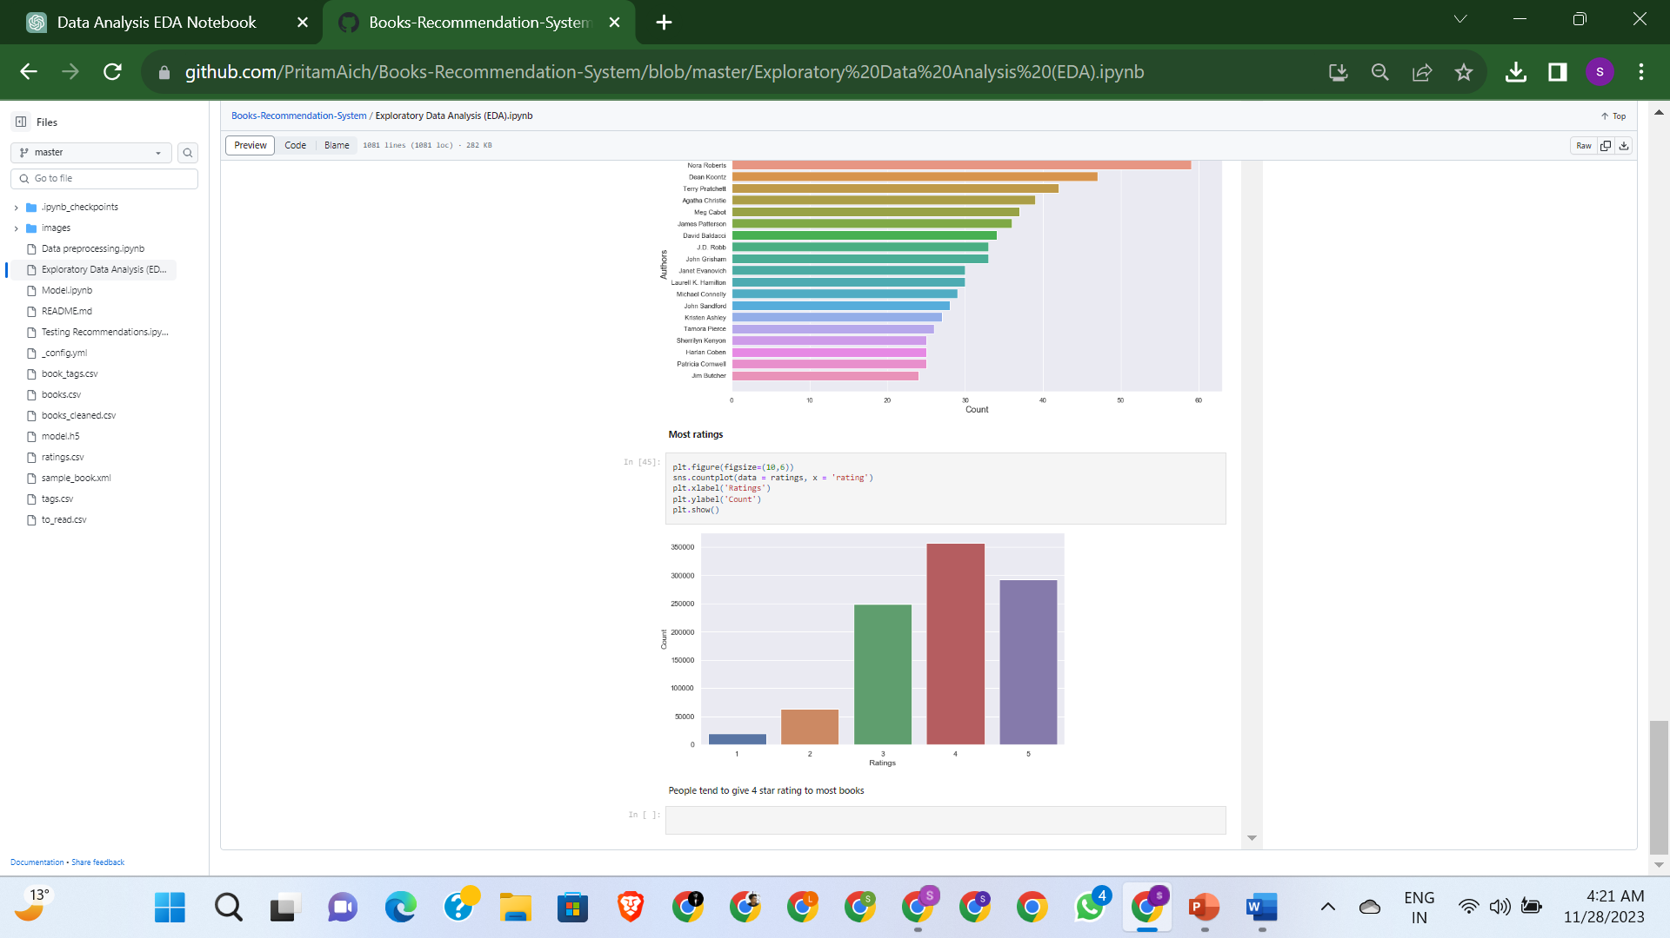

Slide 14
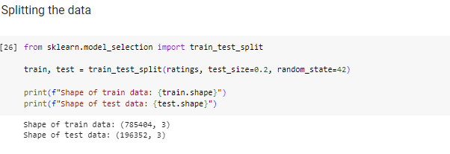
3. MODEL DEVELOPMENT
Dataset Preparation:
The dataset was split into a training set and a test set using an 80-20 ratio.

Slide 15
Neural Network Architecture
Input Layer for Books
Embedding layer for books
Flatten
Concatenation layer
Dense Layer
Dropout layer
Output Layer
Flatten
Input Layer for Users
Embedding layer for users

Slide 16
3. MODEL DEVELOPMENT
Embedding Layers Implementation:
An embedding layer for books and another for users were created.
These layers transform the input book and user IDs into dense vectors of fixed size.
The output of the embedding layer is flattened.
Layer Concatenation and Dense Layer Addition:
The outputs from the book and user embedding layers were concatenated.
A dense layer with 128 neurons was added on top, including a dropout layer with a rate of 0.5 to prevent overfitting.
The activation function used in the dense layer is the Rectified Linear Unit (ReLU).
Dropout Layer:
Dropout is a regularization technique where randomly selected neurons are ignored
during training, which helps in preventing the model from overfitting.

Slide 17
3. MODEL DEVELOPMENT
Model Compilation and Training:
The model is compiled with the Adam optimizer, with a custom learning rate of 0.001 and a decay rate of 1e-06.
The loss function used is Mean Squared Error (MSE).
The model is trained on the training set and validated on the test set over 15 epochs. The training process showed a gradual decrease in loss, indicating learning and improvement over time.
We have used EarlyStopping callback function to prevent the overfitting. The training stops early if the validation loss doesn’t improve in the subsequent epoch.

Slide 18
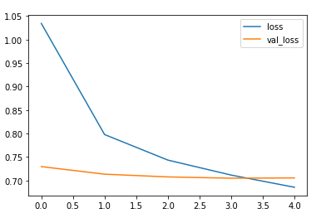
3. MODEL DEVELOPMENT
"loss" is the training loss. It shows how the model's loss has decreased over time as it learns from the training data.
"val_loss" is the validation loss. This shows how well the model is generalizing to new data it hasn't seen before.
Loss Value
No of Epochs

Slide 19
3. MODEL DEVELOPMENT
Model Performance and Saving:
The model's performance improved over the epochs, as evidenced by the decreasing loss values.
After training, the model was saved for later use in making book recommendations.

Slide 20
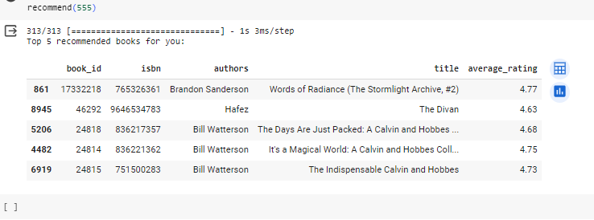
RESULT
Recommendations:
The pre-trained model along with the books and ratings datasets were loaded. The book recommendations are generated based on the information available in the books dataset.
A function was defined to accept a 'user_id' as input. This function is designed to return the top 5 recommended books specifically tailored for the user corresponding to the provided 'user_id’.

Slide 21
Future Enhancements
Book summarizer- Book summarizers provide concise overviews of the content within a book. They offer a brief yet informative presentation.
Context-Aware Recommendations:: enhancing recommendations by considering contextual information, such as user location, time of day, and user activity.
Hybrid Models: Combining collaborative filtering with content-based or hybrid models can provide more robust recommendations.

Slide 22
REFERENCES
https://www.kaggle.com/datasets/zygmunt/goodbooks-10k

Slide 23
CONCLUSION
For Users:
Personalized Experience
Discovery of Products
Time-Saving
For Businesses:
Increased Sales and Revenue
Customer Retention
Competitive Advantage

Slide 24
THANK YOU ☺

